Slide 1
Week 5 Practice: Dynamic Programming
Il-Chul Moon
Department of Industrial and Systems Engineering
KAIST

Slide 2
Short recap

Slide 3
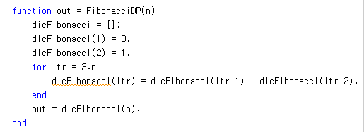
Implementation Example: Fibonacci Sequence in DP
Setting up a memoization table
Building up a bigger solutions
Use an array variable type for memoization
Memoization
Storing a fibonacci number for a particular index
Now,
We have a new space requirement, the table, of O(N)
We have reduced execution time from O(2^{n}) to O(N)

Slide 4
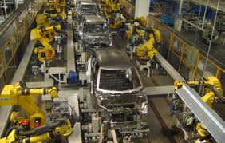
Assembly Line Scheduling
Assembly Line 1
station S_{1,1}
station S_{1,2}
station S_{1,3}
station S_{1,4}
station S_{1,5}
station S_{1,6}
7
9
3
4
8
4
2
1
3
4
3
2
3
Production Start
Production End
2
1
2
2
1
4
2
8
5
6
4
5
7
station S_{2,1}
station S_{2,2}
station S_{2,3}
station S_{2,4}
station S_{2,5}
station S_{2,6}
Assembly Line 2
Time Cost
Goal: Computing the fastest production route

Slide 5
Process of Assembly Line Scheduling
station S_{1,1}
station S_{1,2}
station S_{1,3}
station S_{1,4}
station S_{1,5}
station S_{1,6}
7
9
3
4
8
4
2
1
3
4
3
2
3
Production Start
Production End
2
1
2
2
1
4
2
8
5
6
4
5
7
station S_{2,1}
station S_{2,2}
station S_{2,3}
station S_{2,4}
station S_{2,5}
station S_{2,6}
Time | 1 | 2 | 3 | 4 | 5 | 6
L1 | 9
L2 | 12
Trace | 1 | 2 | 3 | 4 | 5 | 6
L1 | S
L2 | S

Slide 6
Process of Assembly Line Scheduling
station S_{1,1}
station S_{1,2}
station S_{1,3}
station S_{1,4}
station S_{1,5}
station S_{1,6}
7
9
3
4
8
4
2
1
3
4
3
2
3
Production Start
Production End
2
1
2
2
1
4
2
8
5
6
4
5
7
station S_{2,1}
station S_{2,2}
station S_{2,3}
station S_{2,4}
station S_{2,5}
station S_{2,6}
Time | 1 | 2 | 3 | 4 | 5 | 6
L1 | 9 | 18
L2 | 12 | 16
Trace | 1 | 2 | 3 | 4 | 5 | 6
L1 | S | 1
L2 | S | 1

Slide 7
Process of Assembly Line Scheduling
station S_{1,1}
station S_{1,2}
station S_{1,3}
station S_{1,4}
station S_{1,5}
station S_{1,6}
7
9
3
4
8
4
2
1
3
4
3
2
3
Production Start
Production End
2
1
2
2
1
4
2
8
5
6
4
5
7
station S_{2,1}
station S_{2,2}
station S_{2,3}
station S_{2,4}
station S_{2,5}
station S_{2,6}
Time | 1 | 2 | 3 | 4 | 5 | 6
L1 | 9 | 18 | 20
L2 | 12 | 16 | 22
Trace | 1 | 2 | 3 | 4 | 5 | 6
L1 | S | 1 | 2
L2 | S | 1 | 2

Slide 8
Tracing Assembly Line Scheduling in DP
Assembly Line 1
station S_{1,1}
station S_{1,2}
station S_{1,3}
station S_{1,4}
station S_{1,5}
station S_{1,6}
7
9
3
4
8
4
2
1
3
4
3
2
3
Production Start
Production End
2
1
2
2
1
4
2
8
5
6
4
5
7
station S_{2,1}
station S_{2,2}
station S_{2,3}
station S_{2,4}
station S_{2,5}
station S_{2,6}
Assembly Line 2
Used for retrace purpose
Time | 1 | 2 | 3 | 4 | 5 | 6
L1 | 9 | 18 | 20 | 24 | 32 | 35
L2 | 12 | 16 | 22 | 25 | 30 | 37
Trace | 1 | 2 | 3 | 4 | 5 | 6
L1 | S | 1 | 2 | 1 | 1 | 2
L2 | S | 1 | 2 | 1 | 2 | 2

Slide 9
Offline class plan

Slide 10
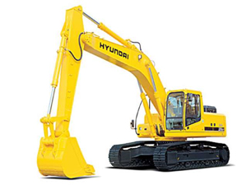
Production Planning Management
Excavator producers in Korea
Hyundai, Doosan…
Excavators are pretty expensive
Start production when orders come in
Any problem?
Orders always change
Cancelling
Changing the delivery date
Changing the specification
Changes get more difficult to handle when they are aggregated for a month-long production list
How to store and manage the production data?

Slide 11
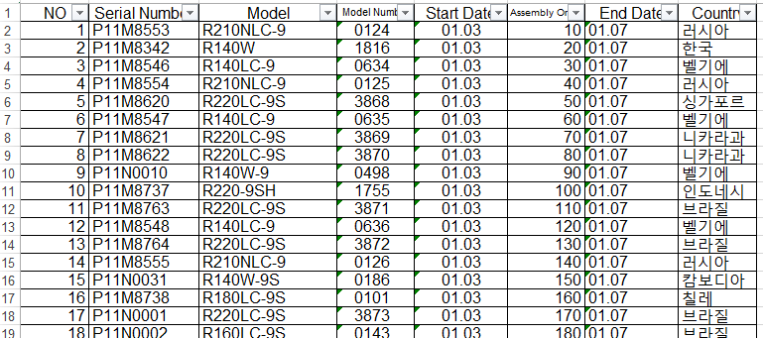
For your information: Dataset
You are given four production plans of excavator production
Plan on Dec 17, 2012
Four columns
No: just a number on the row
Serial Number: Unique identifier of an order
Model: Model name of the excavator
Model Number: The unique number of the product in the model line
Start Date: Production start date
Assembly Order: Production order
End Date: Production end date
Country: Order origination

Slide 12
Manufacturing Execution System
Line 1
Processor 1
Processor 2
Processor 3
Planned Product
In the code, we have two lines with five processors
Finished Product
Line 2
Processor 4
Processor 5
Processor 6
Now, processors can break down with a probability
Then, the processor will not process the product at the turn
Each product in the processors will make “1” cost
Then, complete the dynamic programming to select a line for the next planned product. Selecting either line 1 or line 2
Complete “selectLine” in Factory.m
Problem 1. Cost calculation with dynamic programming

Slide 13
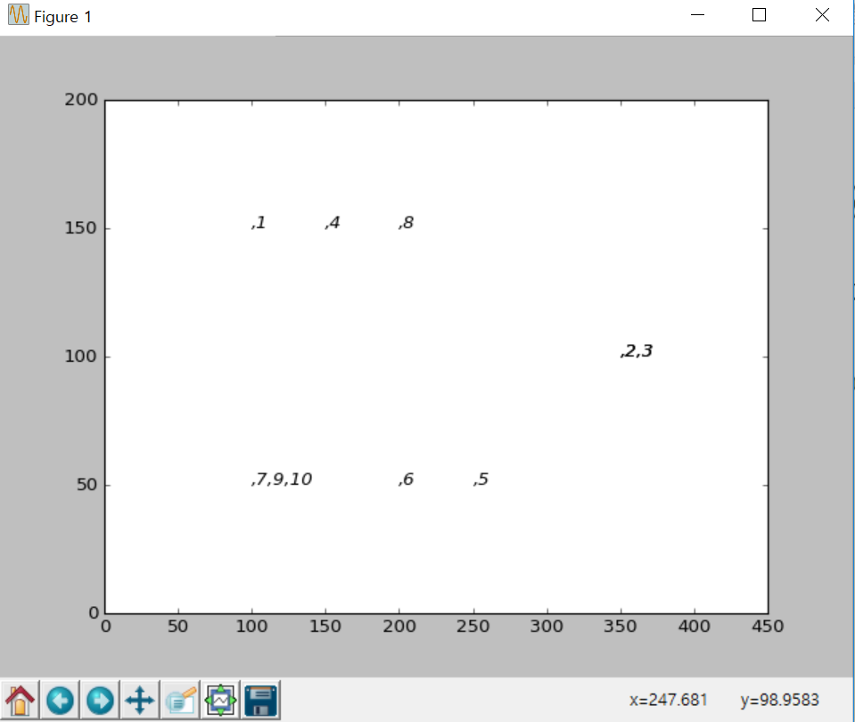
Execution Result
When you complete the codes, you are expected to see the below results.
Execute ‘main.py’
f=Factory(Filename,0.3)
Break down Probability

